Slide 1
HHS UK Analyst Exchange
02 February 2018

Slide 2
Introduction
This presentation will cover:
Exchange overview
Deep dive into main topics
Opioid summary and recommendations
Antimicrobial resistance recommendations
Other challenges/opportunities
Looking forward

Slide 3
Exchange overview

Slide 4

Information Sharing
HHS context
Code-athon
KidneyX
Data Science colab
NCHS
DeBeaumont
AR
Notes:
The first of its kind?
A packed schedule
Numerous SME meetings – knowledge sharing

Slide 5
Opioid summary and recommendations

Slide 6
Risk Stratification
Risk estimates are calculated from related patient characteristics i.e.. Age, gender, education, healthcare provider, etc.
Stratify for the risk of overdose i.e.. hospital admissions
Developed into tool/dashboard for:
Population view
Patient view

Slide 7
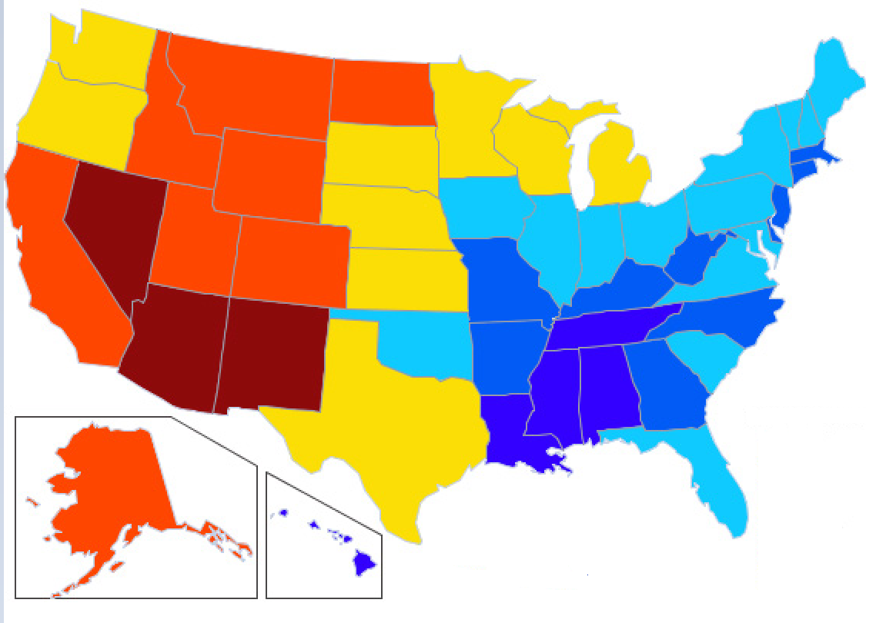
Risk Stratification: Population View
Calculated using population estimates
Drill down National > State > County

Slide 8
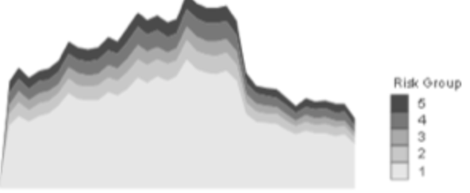
Risk Stratification: Patient/Medicine View
Calculated using clinic patient cohorts
Shows risk levels individually for patient characteristics
Further stratification by medicine possible

Slide 9
Calculation of patient risk
Patient₁ Risk
Patient₂ Risk
Expected Overdoses
Patient.. Risk

Slide 10
Patient risk variables for Opioids:
Age
Gender
Ethnicity/Race
Employment
Education level
Previous Opioid prescriptions
Living arrangement
Mental Health Disorder – ICD10 codes
Jail/prison history
Health care provider

Slide 11
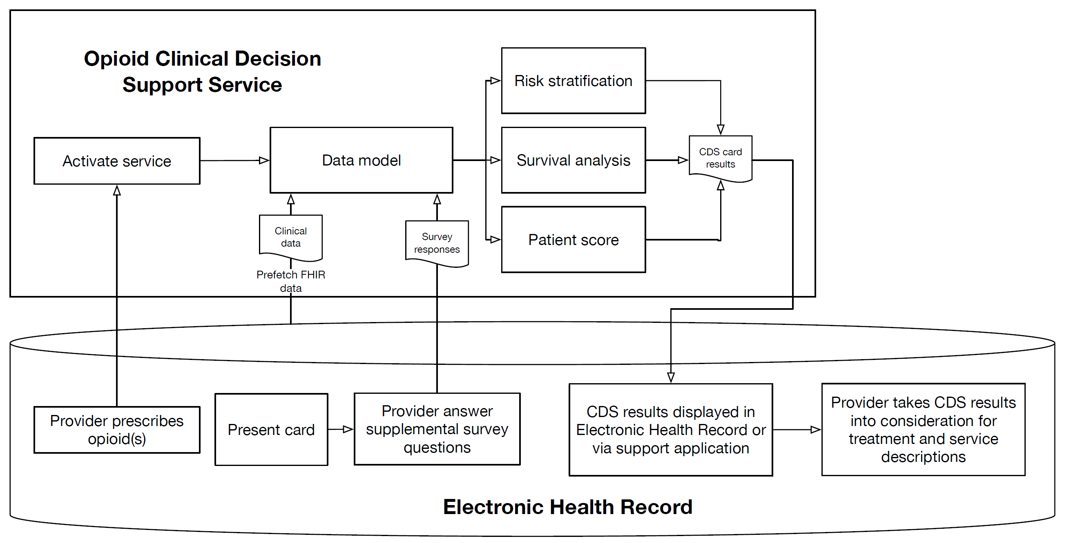
EHR/FIHR

Slide 12
Prioritising Treatment - Survival Analysis
Adverse event – Overdose
Cox proportional hazards regression model
Estimate the duration of event-free time.
Risk of event happening at particular point in time given that it has not happened already.
Identify variables that are significant predictors of the time to event (e.g. demographics, substance type, geographical location).

Slide 13
Prioritising Treatment - Survival Analysis
Variables required:
Outcome variable (time to event) = duration between a start point (substance abuse diagnosis, hospital admission, previous overdose) and next overdose.
Predictor variables - e.g. age, gender, location, substance type
Outcome – direct treatment towards those above a threshold probability of overdose at a given point in time.

Slide 14
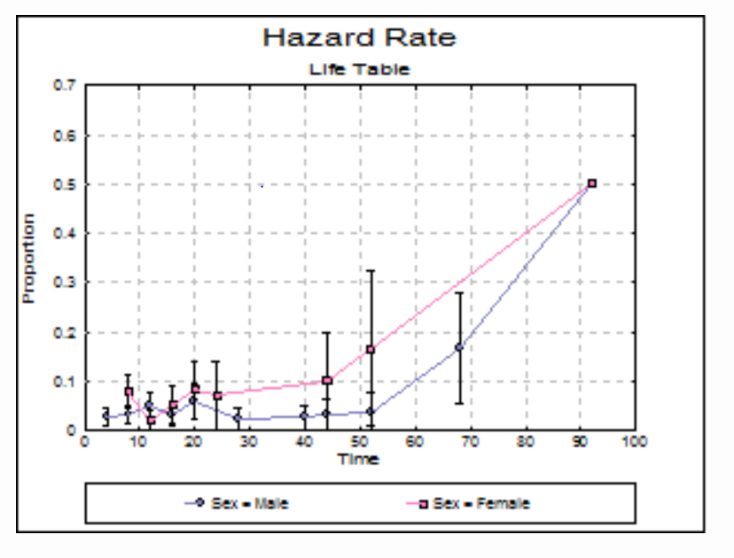
Prioritising Treatment - Survival Analysis

Slide 15
Survival Analysis - TEDS A/D
Relevant dataset - Treatment Episode Dataset (TEDS-A/D)
Admissions to and discharges from substance abuse treatment facilities
Admission based dataset
60% of states reported data on admissions to eligible facilities
Purpose of survival analysis – to provide treatment in the community before admission becomes necessary

Slide 16
Survival Analysis - TEDS A/D
Event - admission to a facility​
Time to event - duration between two consecutive admissions​
Potential predictors:
Demographics - age, gender, ethnicity
Education and employment
Substance type and frequency of use
Number of prior treatment episodes and age at first use
Length of stay and reason for discharge

Slide 17
Tracking demand for information and services
Use digital analytics on health-related websites to track:
Volume of usage on pages linked to painkillers, addiction or substance abuse.
Frequency of website searches for these topics
Demand for service-related information
Location-specific analyses to identify hotspots
NHS Choices:
Health A-Z for conditions: e.g. drug addiction, pain-related conditions
Find services

Slide 18
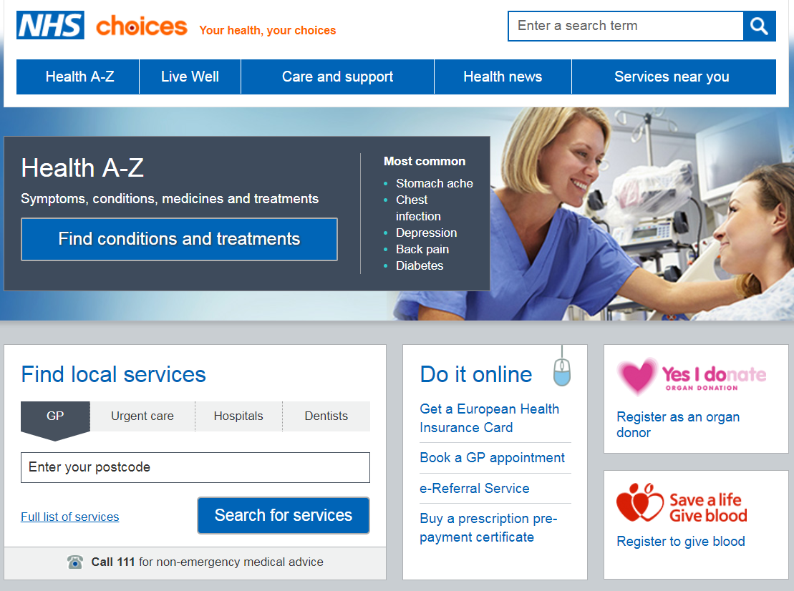
NHS Choices

Slide 19
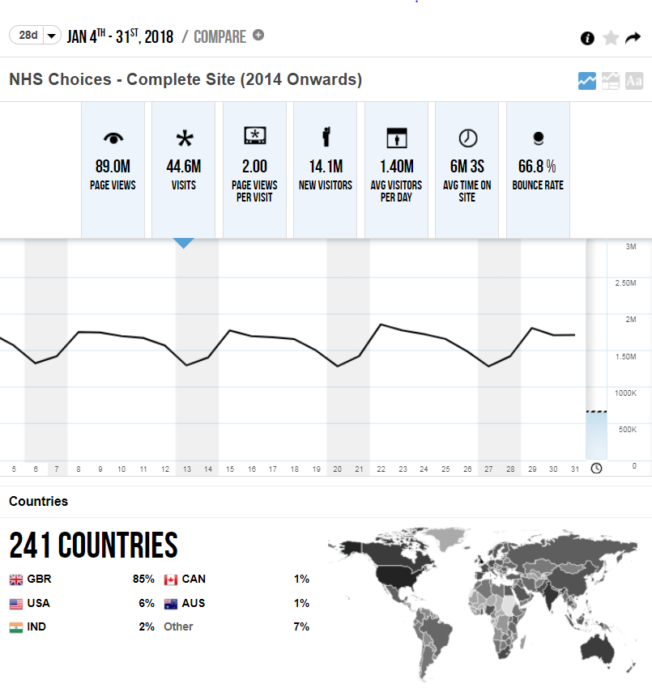
Tracking demand for information and services

Slide 20
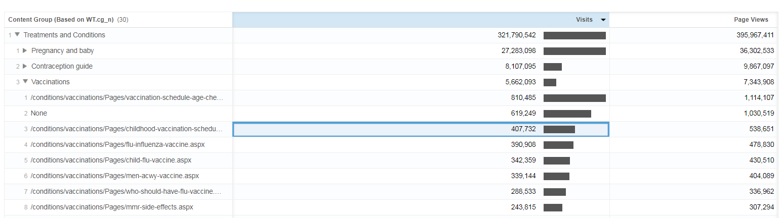
Tracking demand for information and services

Slide 21
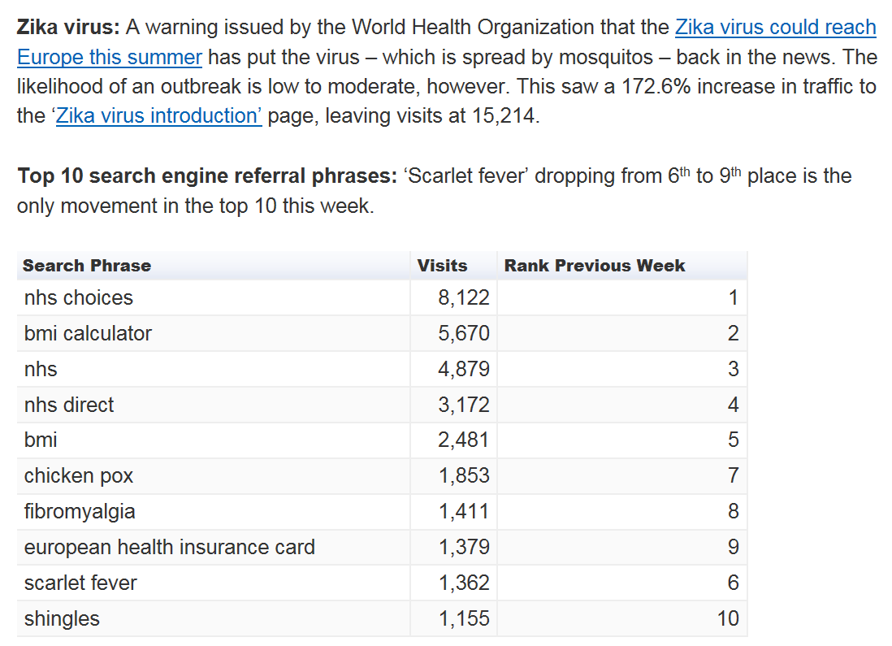
Tracking demand for information and services

Slide 22
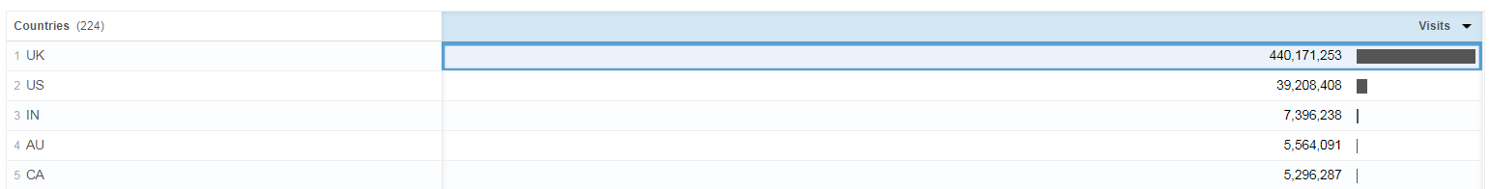
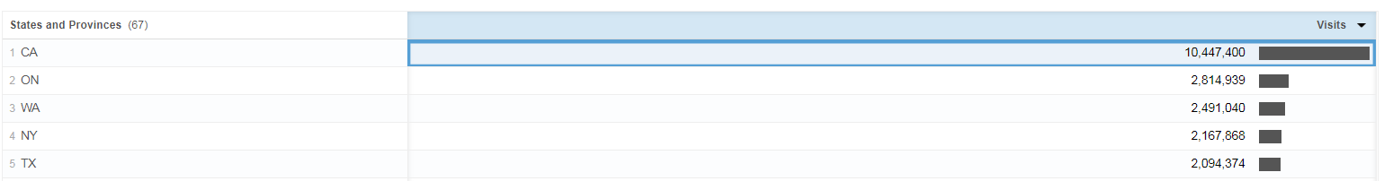
Tracking demand for information and services

Slide 23
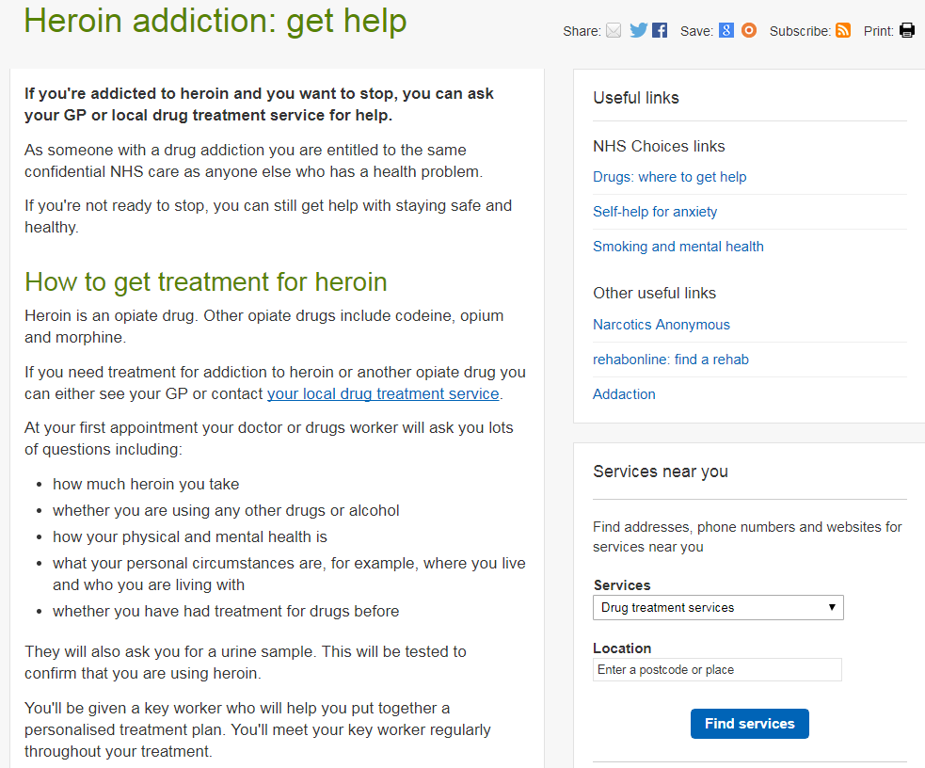
NHS Choices - Heroin Addiction

Slide 24
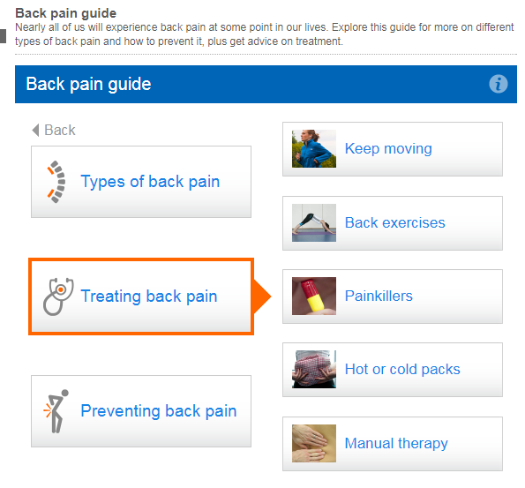
NHS Choices - Back Pain

Slide 25
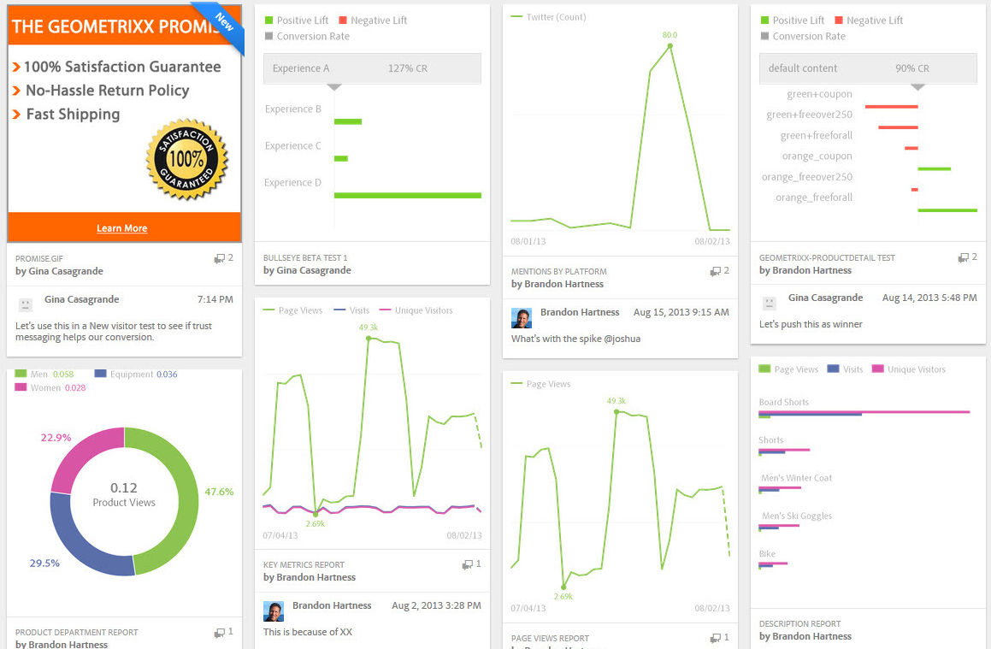
Dashboard

Slide 26


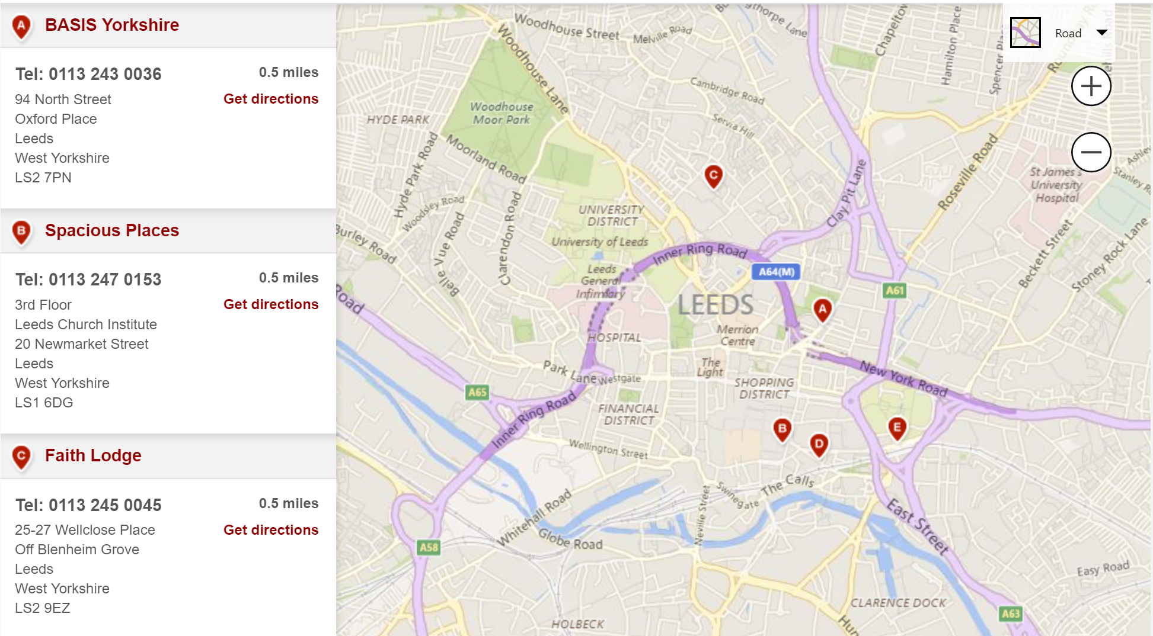
Opioid treatment centres near you
Notes:
Discuss analysis of NHS Choices data - use postcode to track whose looking for services and demand on service in the areas

Slide 27
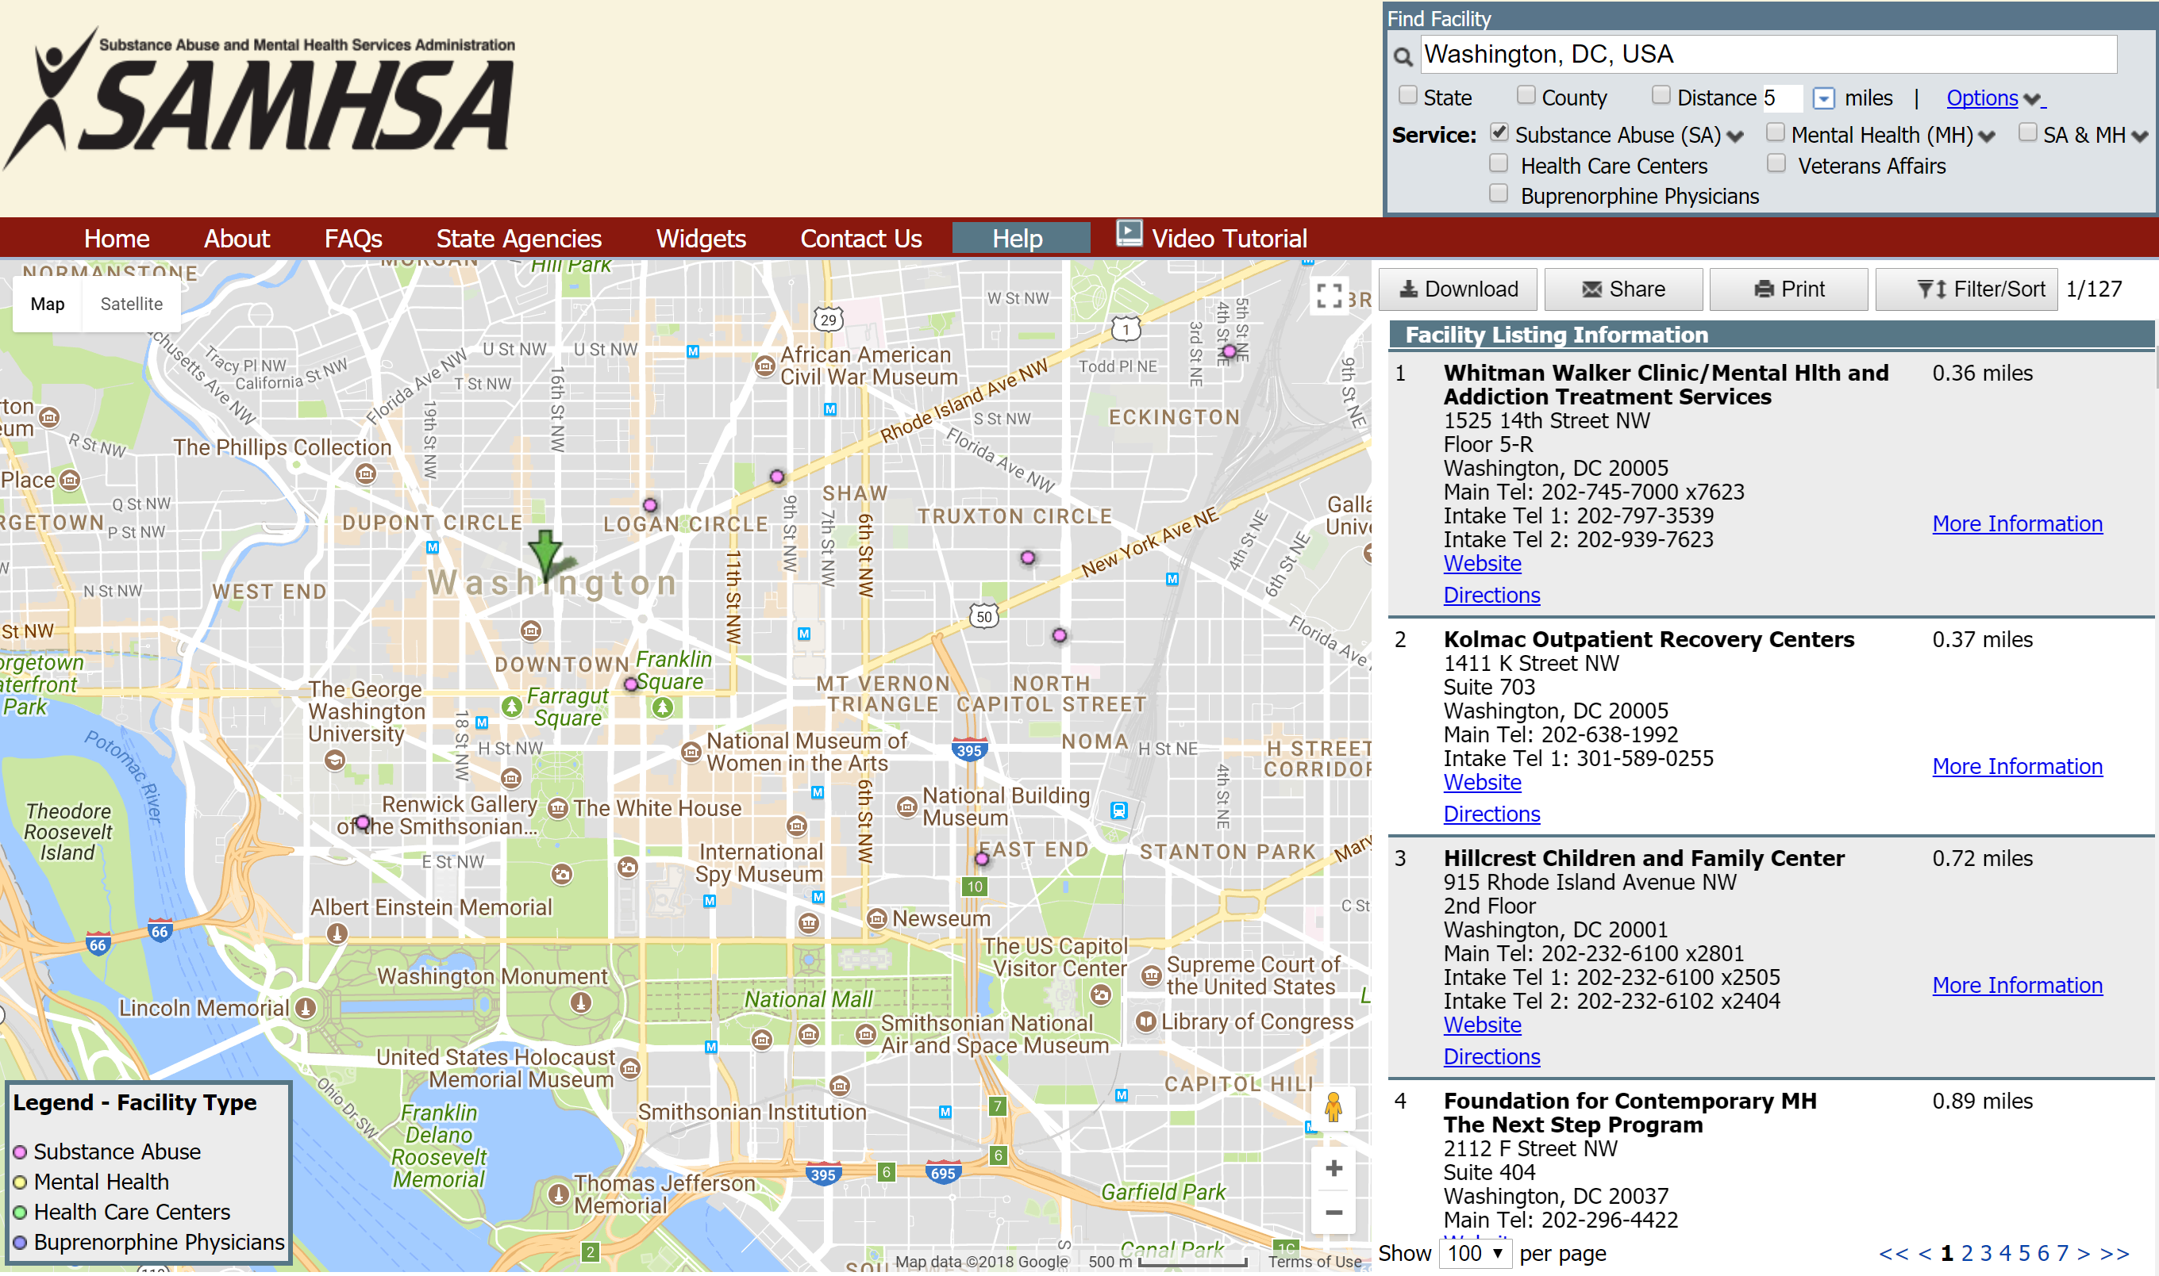
Quantifying demand for services by location
Notes:
Collect data from website like SAMHSA or Kolmac
Influence use of tools - website which appears on data searches
Analyse searches and zip codes for treatment centre demand information – State level departments, County level - use to discover regional hotspots and tailor treatment
Use regional information to deliver education to first responders/police

Slide 28





Recovery of opioid users
Health: Overcoming or managing Home: A stable and safe place to live.
one’s disease(s) as well as living in
a physically and emotionally healthy way.
Purpose: Meaningful daily activities, Community: Relationships and social networks
and the independence, income, that provide support, friendship,love,and hope
and resources to participate in society.
.

Slide 29
Antimicrobial resistance recommendations

Slide 30
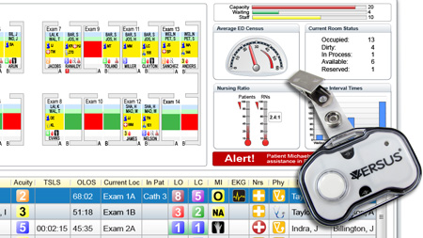
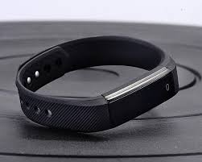
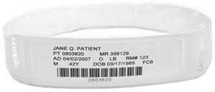
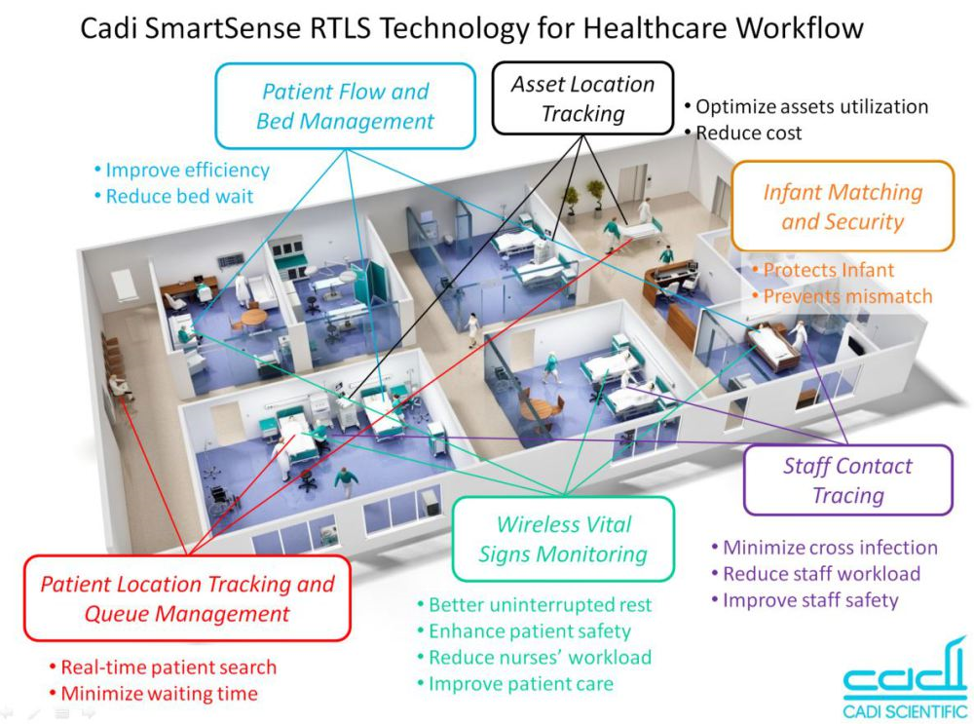
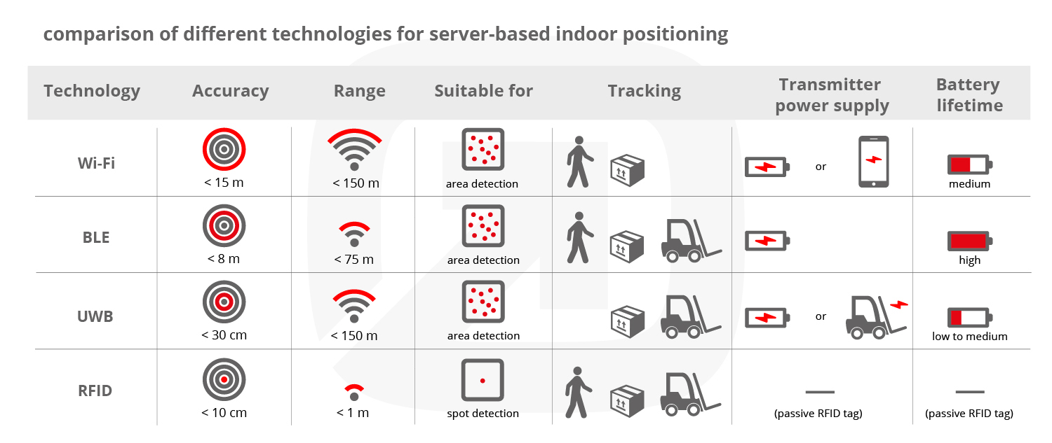
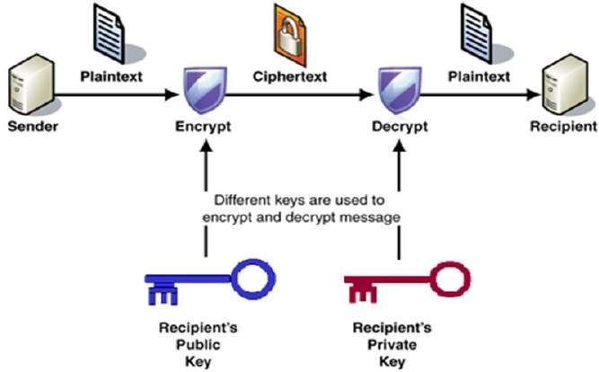


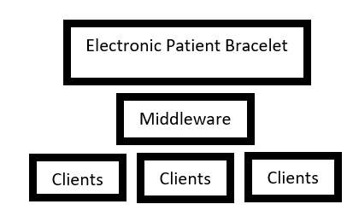
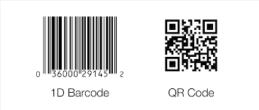
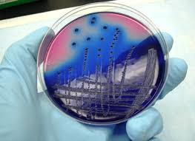
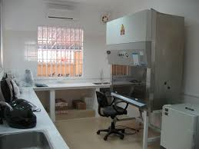
Real Time Patient Tracking
RTLS Technology combined with Patient ID bracelet
Patient and Staff
Wi-fi Technology
Encrypted
Biometric Security
Built to be interoperable
Scanner and Display
Link to smart instruments

Slide 31
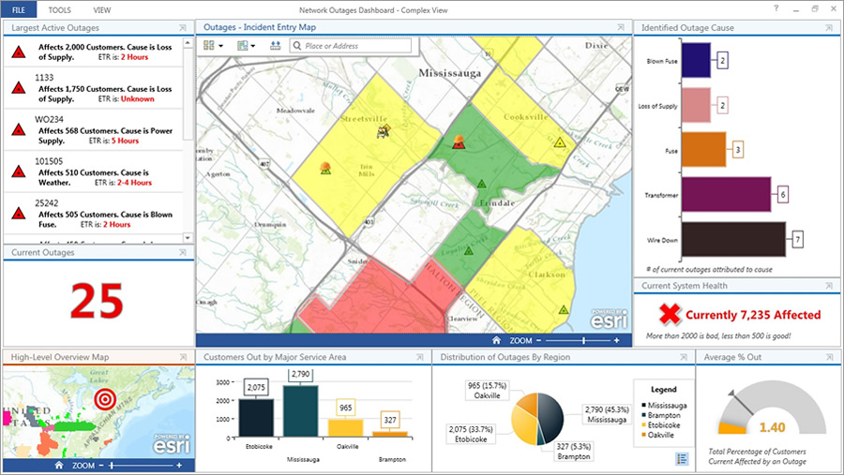

Real Time Patient Tracking
GIS portal

Slide 32
Monitoring – Medicines Optimisation
Medicines Optimisation Dashboard
allows local healthcare organisations to highlight variation in local practice and provoke discussion on the appropriateness of local care
not intended as a performance measurement tool
Antimicrobial focus but can be used for any number of medicines
Uses national prescribing measures such as STAR-PUs

Slide 33
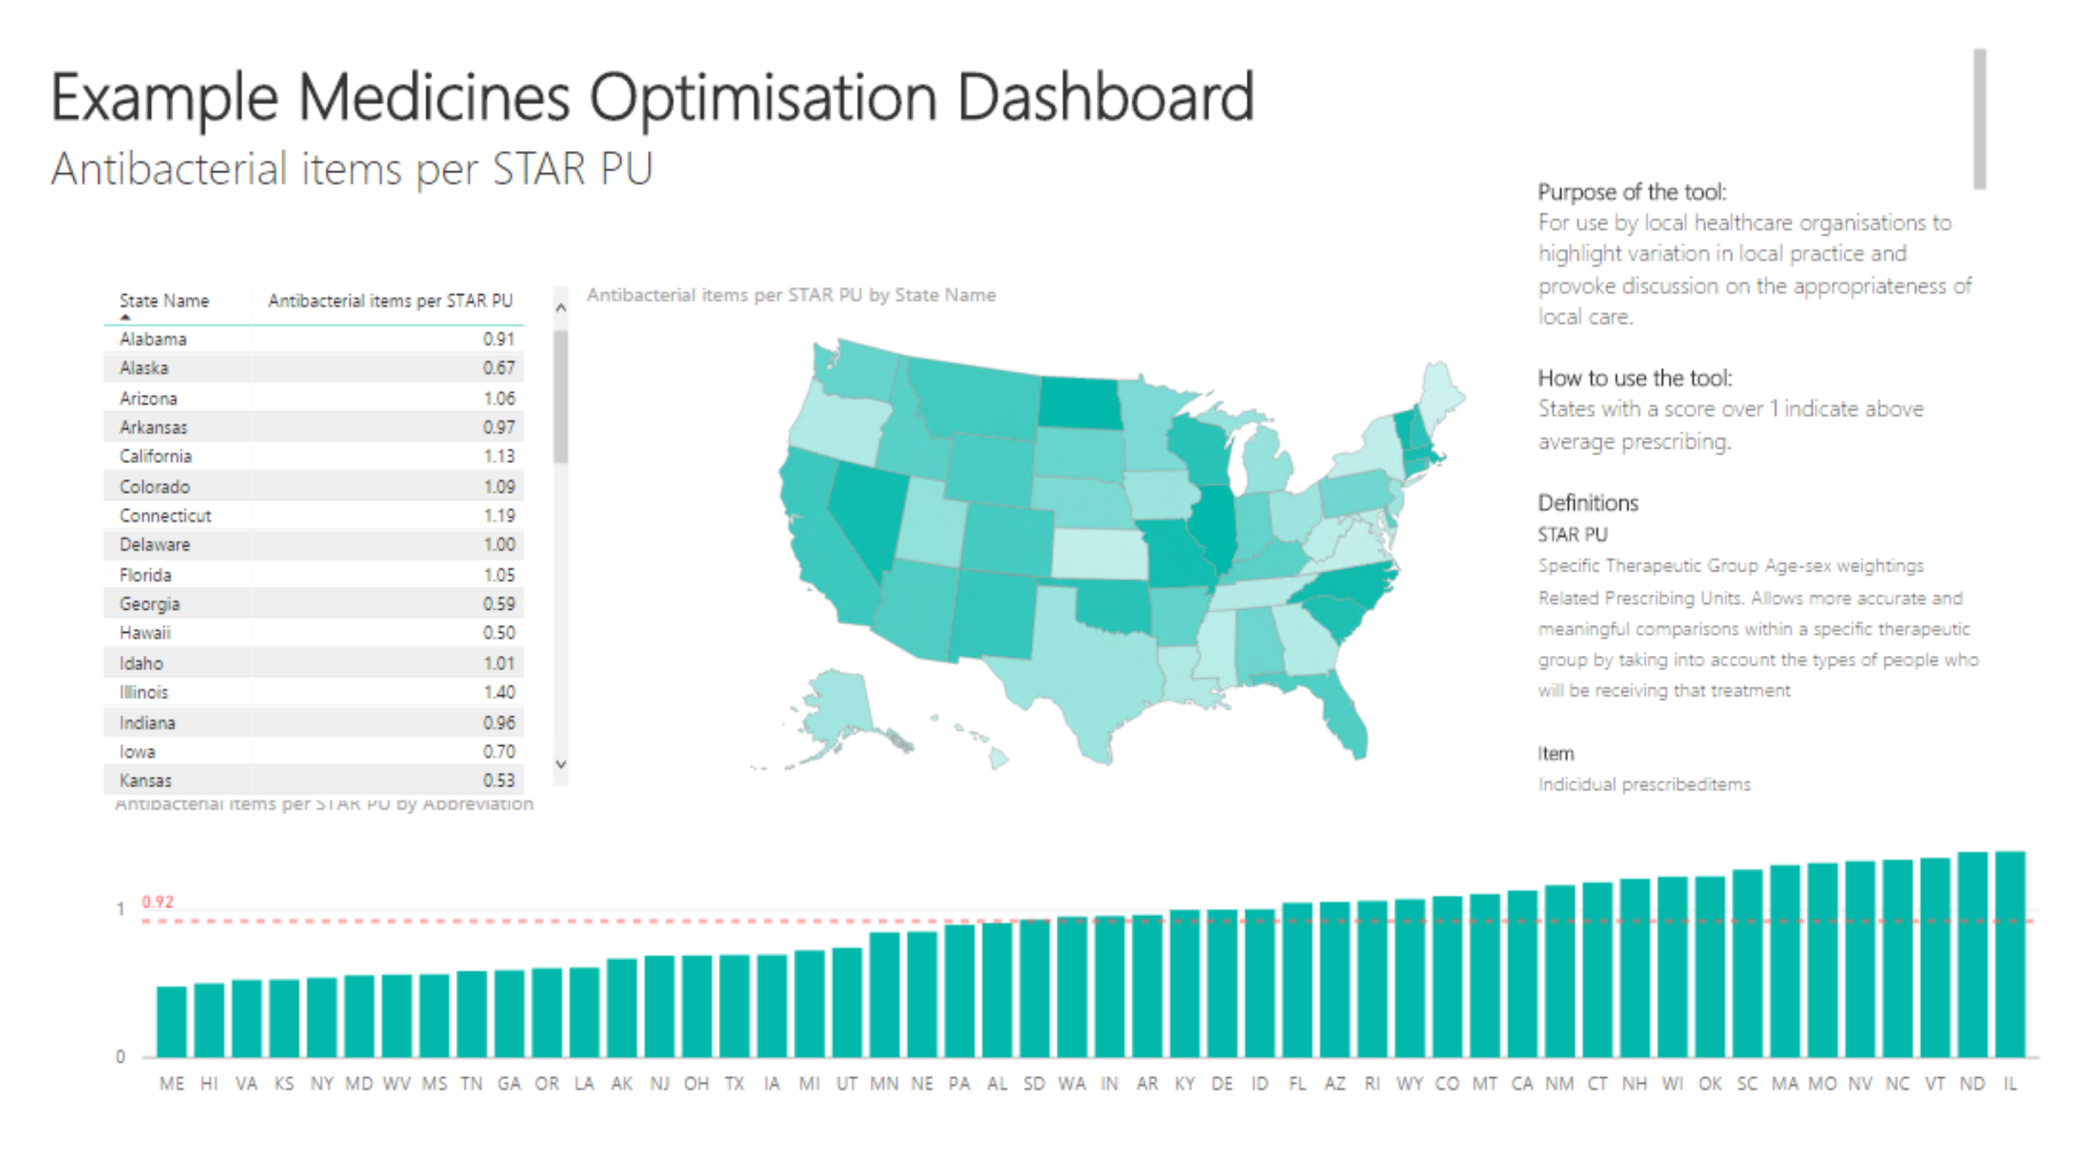
Monitoring – Medicines Optimisation
https://app.powerbi.com/view?r=eyJrIjoiNjZjMjNhMzctOWFiNi00ZDYwLWIxYTktMTFkMTM2NWQzZjg0IiwidCI6IjUwZjYwNzFmLWJiZmUtNDAxYS04ODAzLTY3Mzc0OGU2MjllMiIsImMiOjh9

Slide 34
Monitoring – Medicines Optimisation
US potential data sources:
Medicare Part D Prescribing Data
Medicare Provider Utilization and Payment Data
Medicare State Utilization Data
Could be expanded to counties and other levels of granularity
Many other features possible, demonstrated in UK version

Slide 35
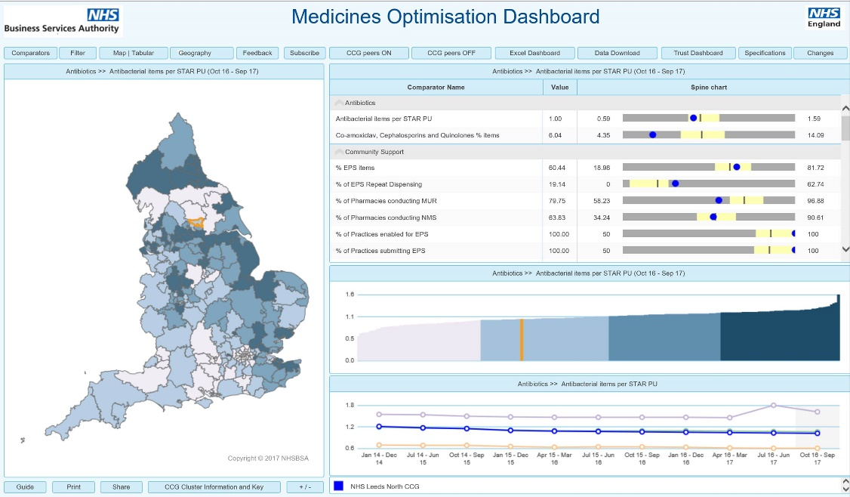
Monitoring – Medicines Optimisation
built using InstantAtlas https://apps.nhsbsa.nhs.uk/MOD/AtlasCCGMedsOp/atlas.html

Slide 36
Medication Safety Project example
Hospital Data
(Patient identifiable)
Prescription Data
(Patient identifiable)
Bridging File
Bridging File
Linked dataset
(Not patient identifiable)

Slide 37
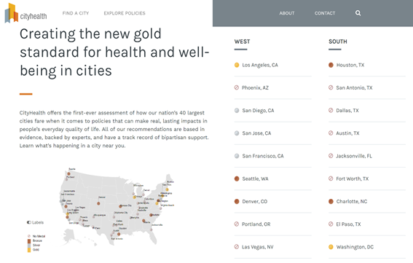
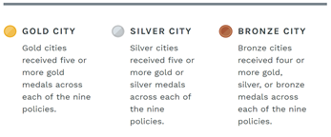
Cityhealth style map to promote AR work
Cityhealth was created by the de Beaumont Foundation and ranks cities based on different variables which have evoked policy change.
Medal system based on variables to rank key cities or states on their effort to prevent resistance.
Use data from CDC MapView webpage and public health information.
Notes:
City health variables = Clean indoor air, paid sic leave, affordable housing, healthy food procurement

Slide 38
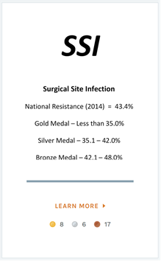
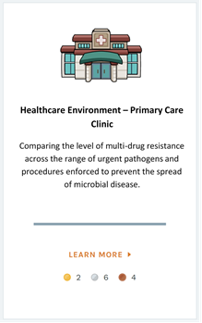
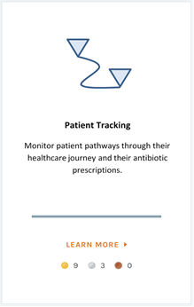
Possible variables
Hospital Associated Infections
Healthcare Environments
Treatment Pathways
Notes:
HAIs: SSI, UTI, BSI - expand to specific pathogens
Hospitals, nursing homes- expand to public places like schools
Patient, prescription, healthcare professionals - reward new developments to improve data linkage

Slide 39
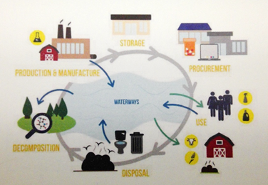
Antimicrobial Resistance 'Code-a-thon'
The purpose of a collaboration event is to develop data-driven solutions to increase surveillance of antimicrobial use and antibiotic resistance
Initial thoughts:
AR Lifecycle
Healthcare Environments
Patient Movement
Image: Jessica Petrillo
Notes:
Mapping the Lifecycle of antibiotics

Slide 40
Other opportunities

Slide 41
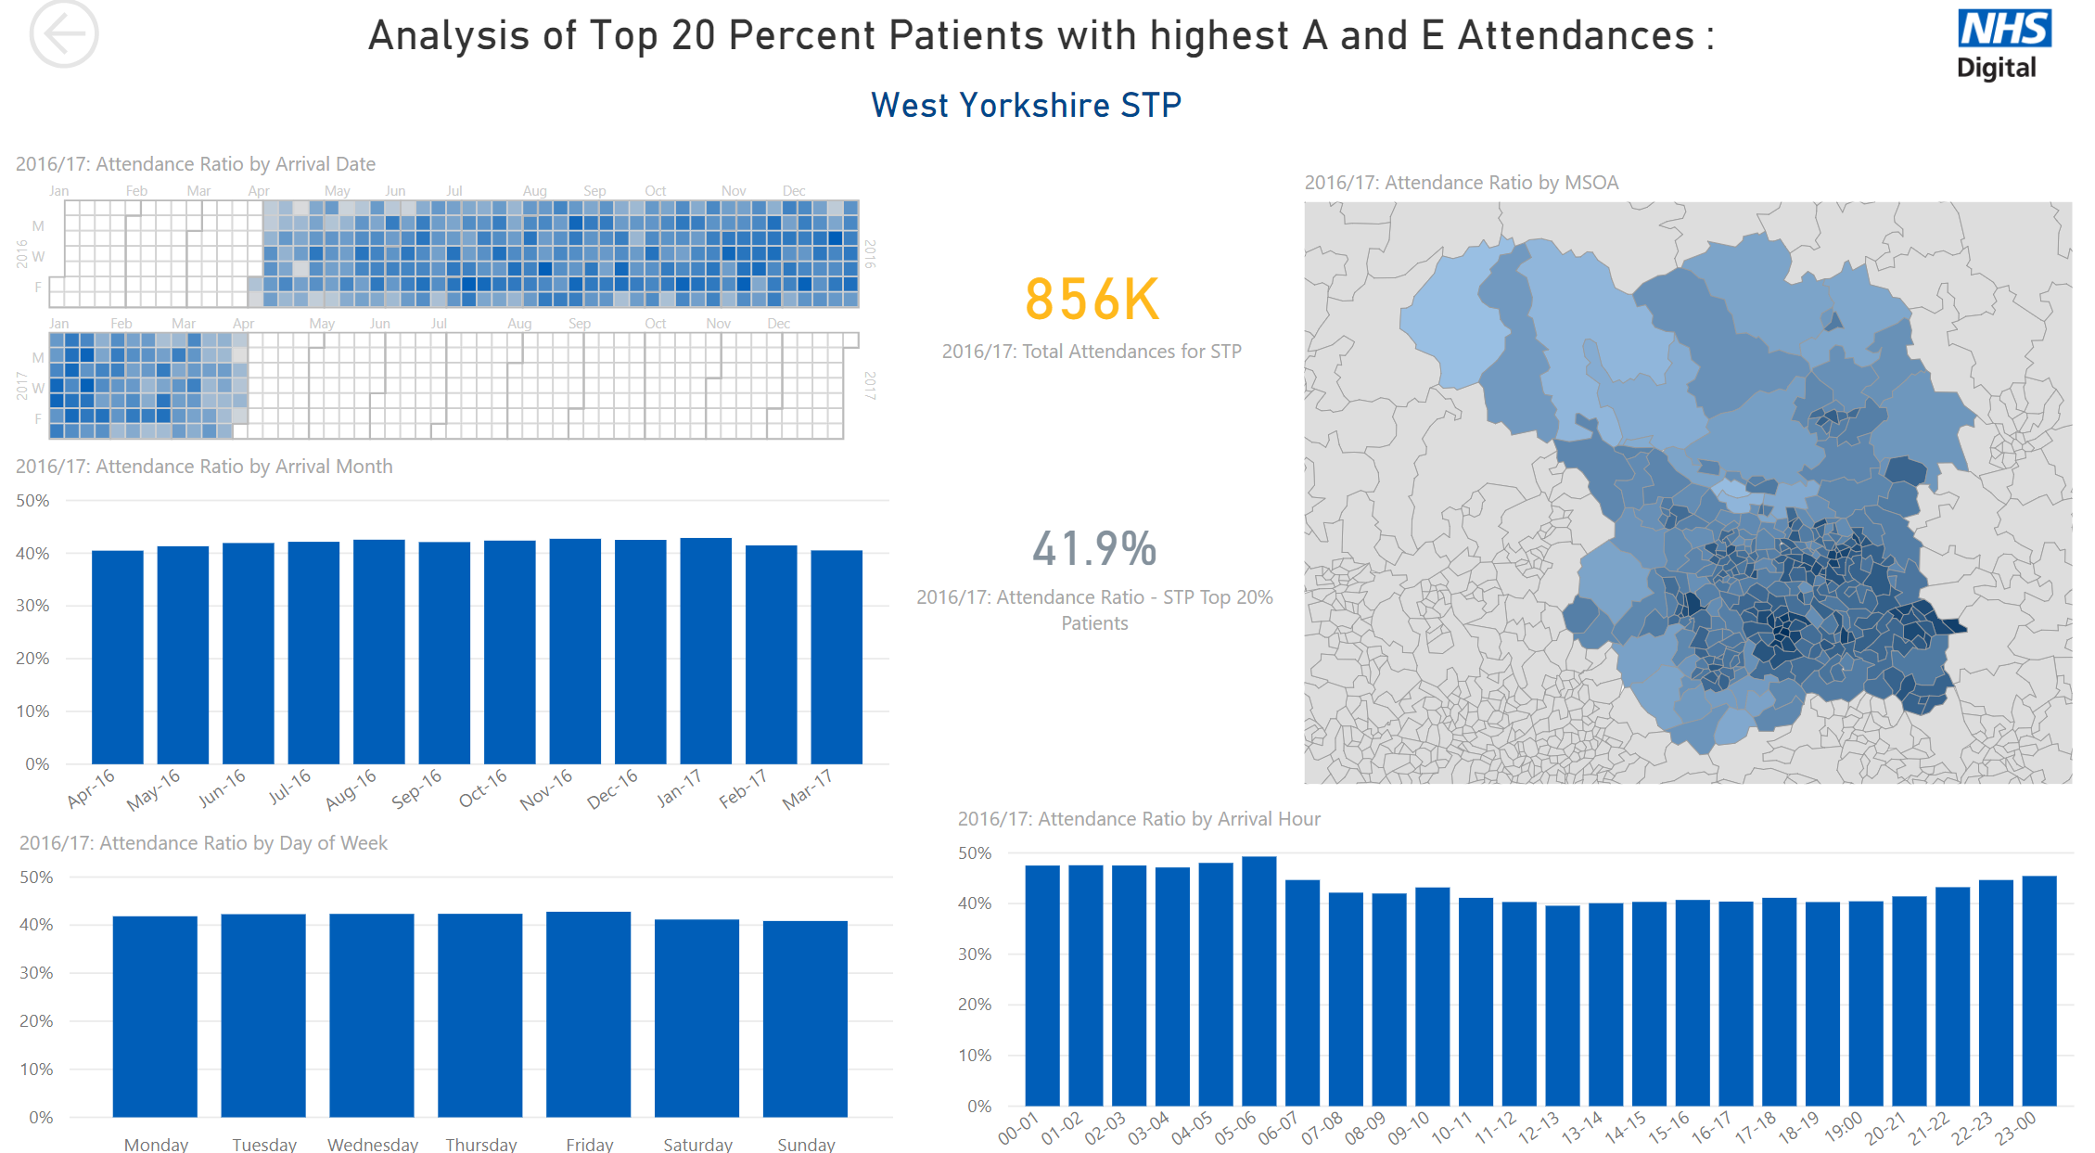
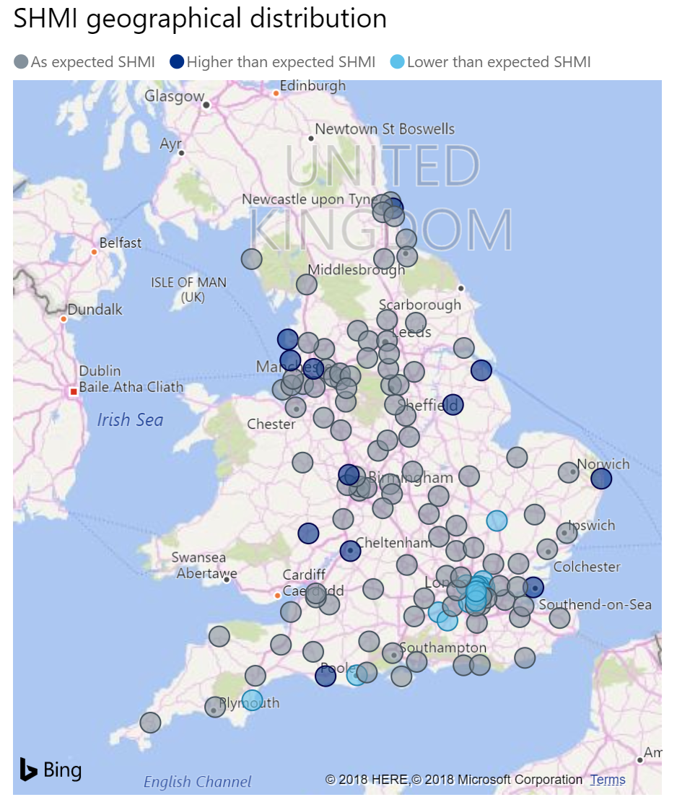
NCHS NHCS data
Synergies with English Hospital Episode Statistics
Collected from patient records during their care in hospital (ED, Outpatient, Inpatient)
Linked to other sources, such as death records, used in a multitude of ways
Notes:
National Centre for Health Stats and the National Health Care Surveys – I love these acronyms
Lots of experience of establishing digital collection of hospital records which Lisa is responsible for. In addition to sharing lessons learned from this process we also have in depth analytical expertise in exploiting the data derived from such systems including linking to other sources, such as mortality data

Slide 42

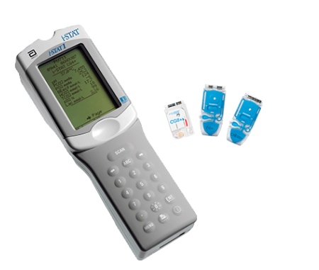
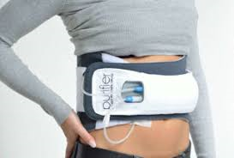
Kidney X
RTLS Technology combined with Patient ID bracelet
Long Term Conditions
Wi-fi Technology
Encrypted
Biometric Security
Built to be interoperable
Scanner and Display
Link to smart instruments

Slide 43
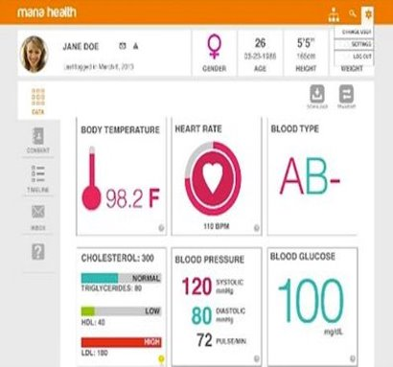
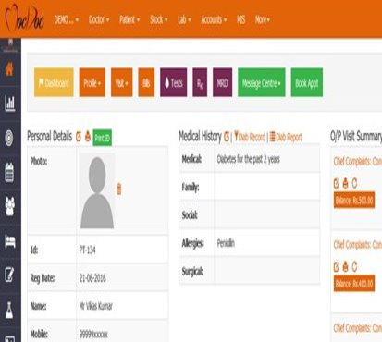
Kidney X
Dashboards for Patient and Health Care Professionals

Slide 44
Looking Forward

Slide 45

Building lasting relationships
This is just the start
Ongoing dialogue
Now – feedback about this week/ priorities to focus on
Next – establish international working group
Later – enhancing proofs of concept

Slide 46

Finally
Thank you

